Slide 1
your pharmacy

Slide 2
about
our web-site is objective is to facilitate the health system by collecting and charing the pharmcytical data base with the back-end user ..and giving him the information he needs ..like the list of pharamcy s available now or later next to u with the possiblitie of knowing in advance if ur medicaments is in the pharamcy selected + if ur medicament dosent need a prespcription u can deliver it .

Slide 3
how the web site workes
-register
-log in
-log out
-home page
-findpage :
-

Slide 4
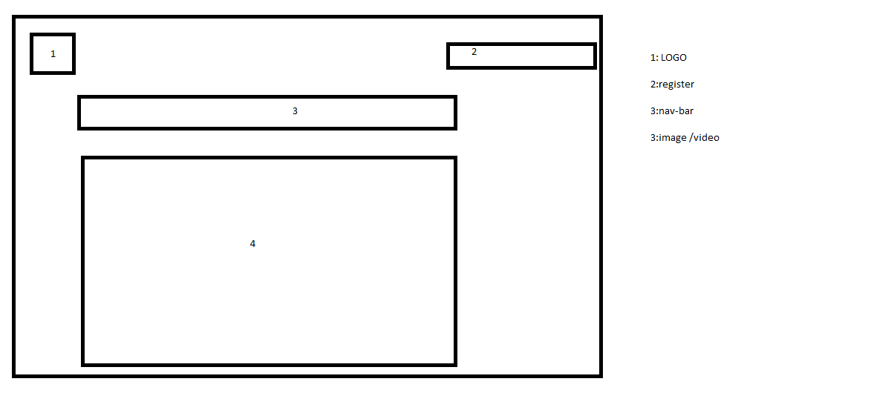

Slide 5
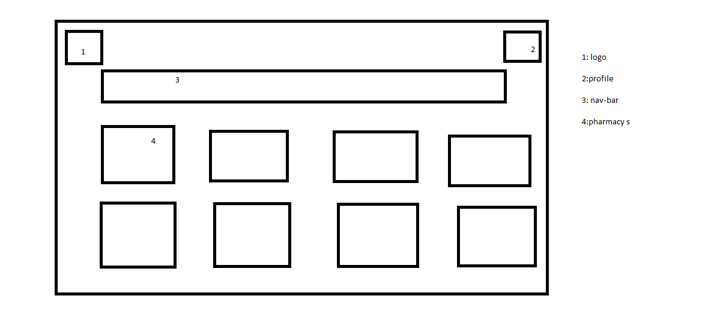

Slide 6
